Slide 1
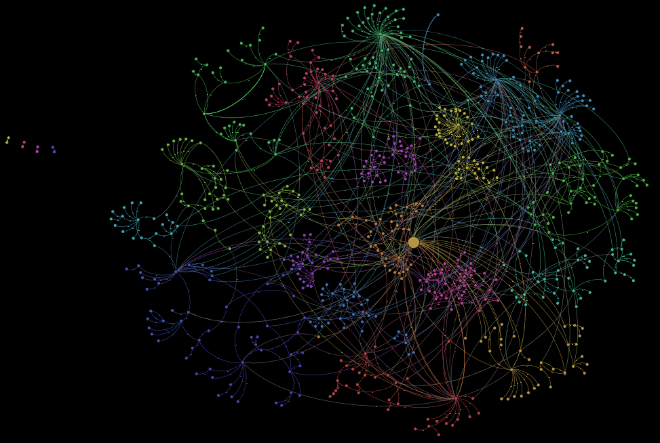


An introduction to Deep Learning on Graphs
Guillaume Jaume
Pre-doctoral researcher
—
gja@zurich.ibm.com
IBM Research, Zürich, Switzerland
LTS5, EPFL, Lausanne, Switzerland
@GuillaumeJaume
guillaumejaume

Slide 2
Outline
Introduction to Graph Neural Networks

Slide 3
Outline
Introduction to Graph Neural Networks
Hands-on exercise:
Predicting molecular properties

Slide 4
Outline
Introduction to Graph Neural Networks
Hands-on exercise:
Predicting molecular properties
Hands-on exercise:
Link prediction on a Knowledge Graph

Slide 5
Outline
Introduction to Graph Neural Networks
Hands-on exercise:
Predicting molecular properties
Hands-on exercise:
Link prediction on a Knowledge Graph
Discussion & References

Slide 6
Before we start
These slides can be found here: https://github.com/guillaumejaume/tuto-dl-on-graphs/blob/main/slides/ml-on-graphs-tutorial.pptx
Setup instructions for the hands-on can be found here:
https://github.com/guillaumejaume/tuto-dl-on-graphs

Slide 7
What you will learn
What are GNNs?

Slide 8
What you will learn
What are GNNs?
When should you use a GNN?

Slide 9
What you will learn
What are GNNs and when to use them
When should you use a GNN?
How to use the Deep Graph Library (DGL)

Slide 10
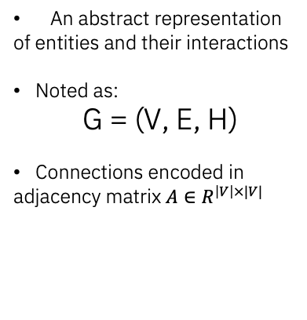
What is a graph?
Nodes
Graph basics
An abstract representation
of entities and their interactions
Noted as:
G = (V, E, H)
Connections encoded in
adjacency matrix $A∈R^{\left|V\right|×|V|}$
Graph
topology
Node features
Edges

Slide 11
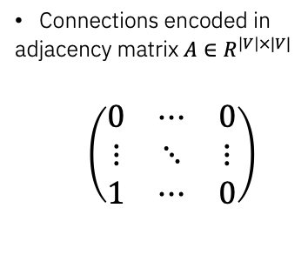
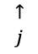
What is a graph?
Nodes
Graph basics
Connections encoded in
adjacency matrix $A∈R^{\left|V\right|×|V|}$
$\left(\begin{matrix}0 & ⋯ & 0 \\ ⋮ & ⋱ & ⋮ \\ 1 & ⋯ & 0\end{matrix}\right)$
Graph
topology
Node features
$$i→$$
$$↑$$
$$j$$
Edges

Slide 12
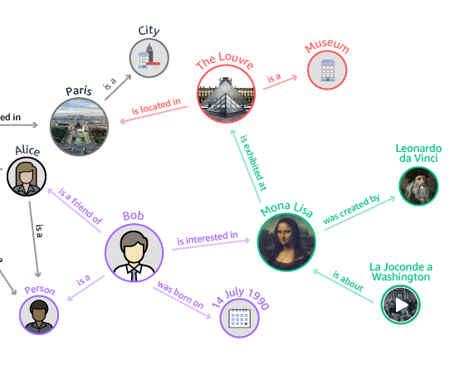
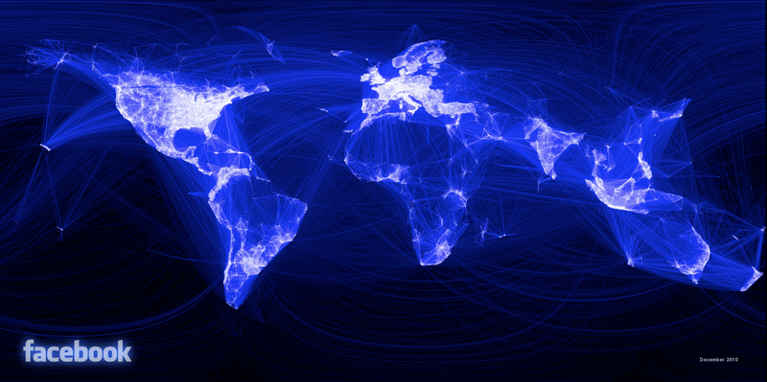
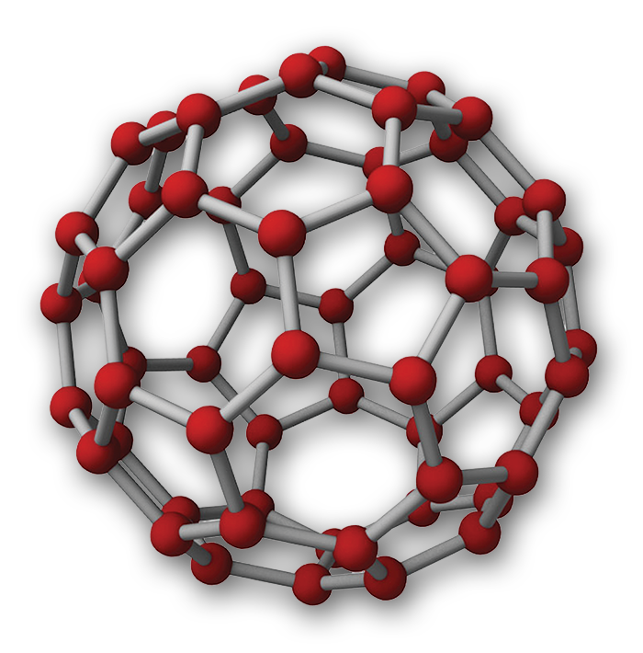
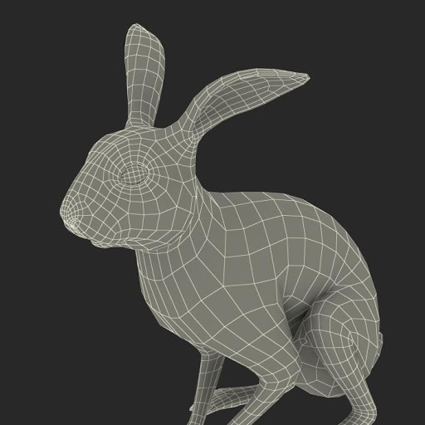

What is a graph?

Slide 13
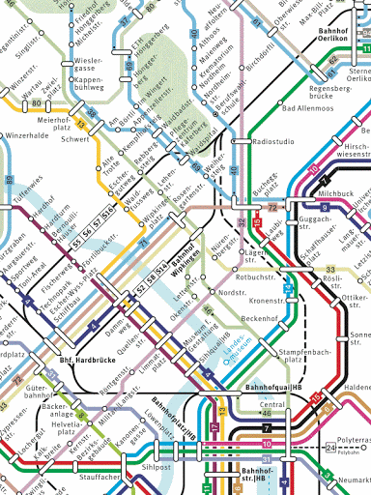


Question time
Which one(s) of these data can be represented as a graph ?
C.) A sentence
A.) A natural image
B.) A tram network

Slide 14
Question time
Which one(s) of these data can be represented as a graph ?
C.) A sentence
A.) A natural image
B.) A tram network

Slide 15
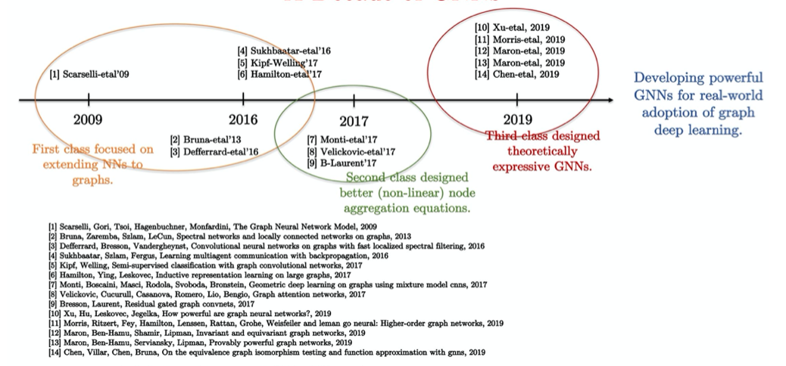
Graph Neural Networks: 10 years of evolution
Source: Xavier Bresson, 2020

Slide 16
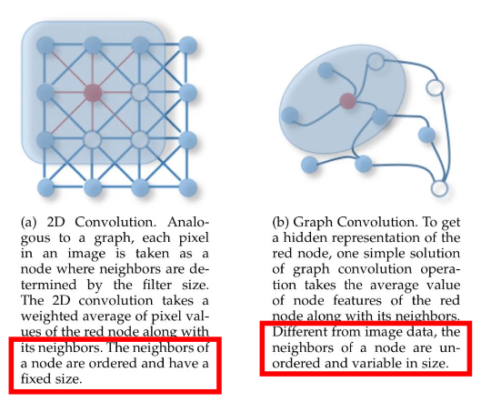
From 2D convolution to graph convolution
How to extend the 2D convolution to arbitrary structures?
2D convolution:
grid graph where each pixel
is connected to its adjacent pixels
Ordered and fixed-size
Graph convolution:
Arbitrary context and neighboorhood
Source: Wu et al., 2019

Slide 17
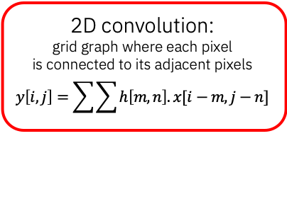
From 2D convolution to graph convolution
How to extend the 2D convolution to arbitrary structures?
2D convolution:
grid graph where each pixel
is connected to its adjacent pixels
$$y\left[i,j\right]=\sum{\sum{h\left[m,n\right].x[i−m, j−n]}}$$
Graph convolution:
Arbitrary context and neighboorhood
Source: Wu et al., 2019

Slide 18
From 2D convolution to graph convolution
How to extend the 2D convolution to arbitrary structures?
2D convolution:
grid graph where each pixel
is connected to its adjacent pixels
Ordered and fixed-size
Graph convolution
needs to be:
Local
Scales to an arbitrary number of neighbors
Scales to an arbitrary number of nodes
Invariant to node permutation
Source: Wu-Etal, 2019

Slide 19
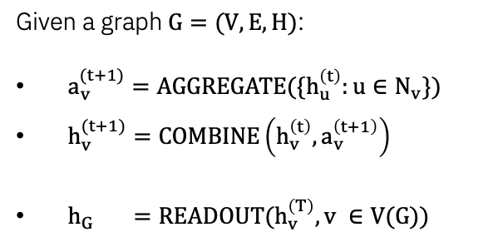
Graph Neural Network
How to extend the 2D convolution to arbitrary structures?
Differentiable &
Permutation-invariant function
GNN key steps
Given a graph $G=(V,E, H)$:
$a_{v}^{(t+1)}=AGGREGATE(\{h_{u}^{\left(t\right)}:u∈N_{v}\})$
$h_{v}^{(t+1)}=COMBINE\left(h_{v}^{\left(t\right)}, a_{v}^{\left(t+1\right)}\right)$
$h_{G} =READOUT(h_{v}^{\left(T\right)}, v ∈V(G))$
Repeat N times
Differentiable function
Differentiable &
Permutation-invariant function

Slide 20
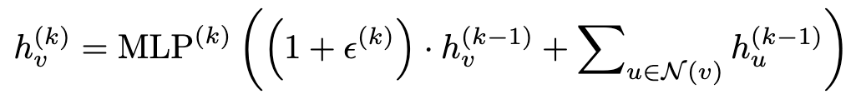
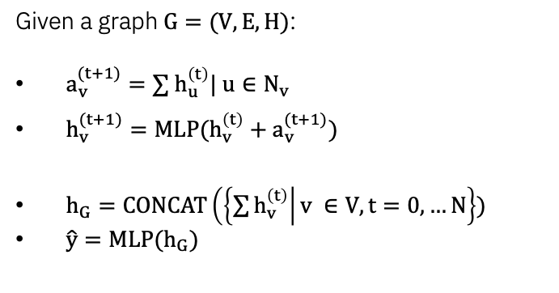
Graph Neural Network
How to extend the 2D convolution to arbitrary structures?
GIN key steps
Given a graph $G=(V,E, H)$:
$a_{v}^{(t+1)}=∑{ h}_{u}^{\left(t\right)}| u∈N_{v}$
$h_{v}^{(t+1)}=MLP(h_{v}^{\left(t\right)}+a_{v}^{(t+1)})$
$h_{G}=CONCAT\left(\left\{\sum{h_{v}^{\left(t\right)}}\right|v ∈V, t=0, …N\right\})$
$\hat{y}=MLP(h_{G})$
Repeat N times
Source: Xu et al., How powerful are Graph Neural Networks? 2020

Slide 21
Question time
Which ones are correct?
A.) GNNs can be seen as a generalization of ConvNets
B.) ConvNets can be seen as a generalization of GNNs
An attention mechanism can be implemented using a GNN
C.) Yes, by building a fully connected graph
D.) Yes, by building an empty graph
E.) No, it is not possible

Slide 22
Question time
Which ones are correct?
A.) GNNs can be seen as a generalization of ConvNets
B.) ConvNets can be seen as a generalization of GNNs
An attention mechanism can be implemented using a GNN
C.) Yes, by building a fully connected graph
D.) Yes, by building a empty graph
E.) No, it is not possible
To convince yourself:
https://thegradient.pub/transformers-are-graph-neural-networks/

Slide 23
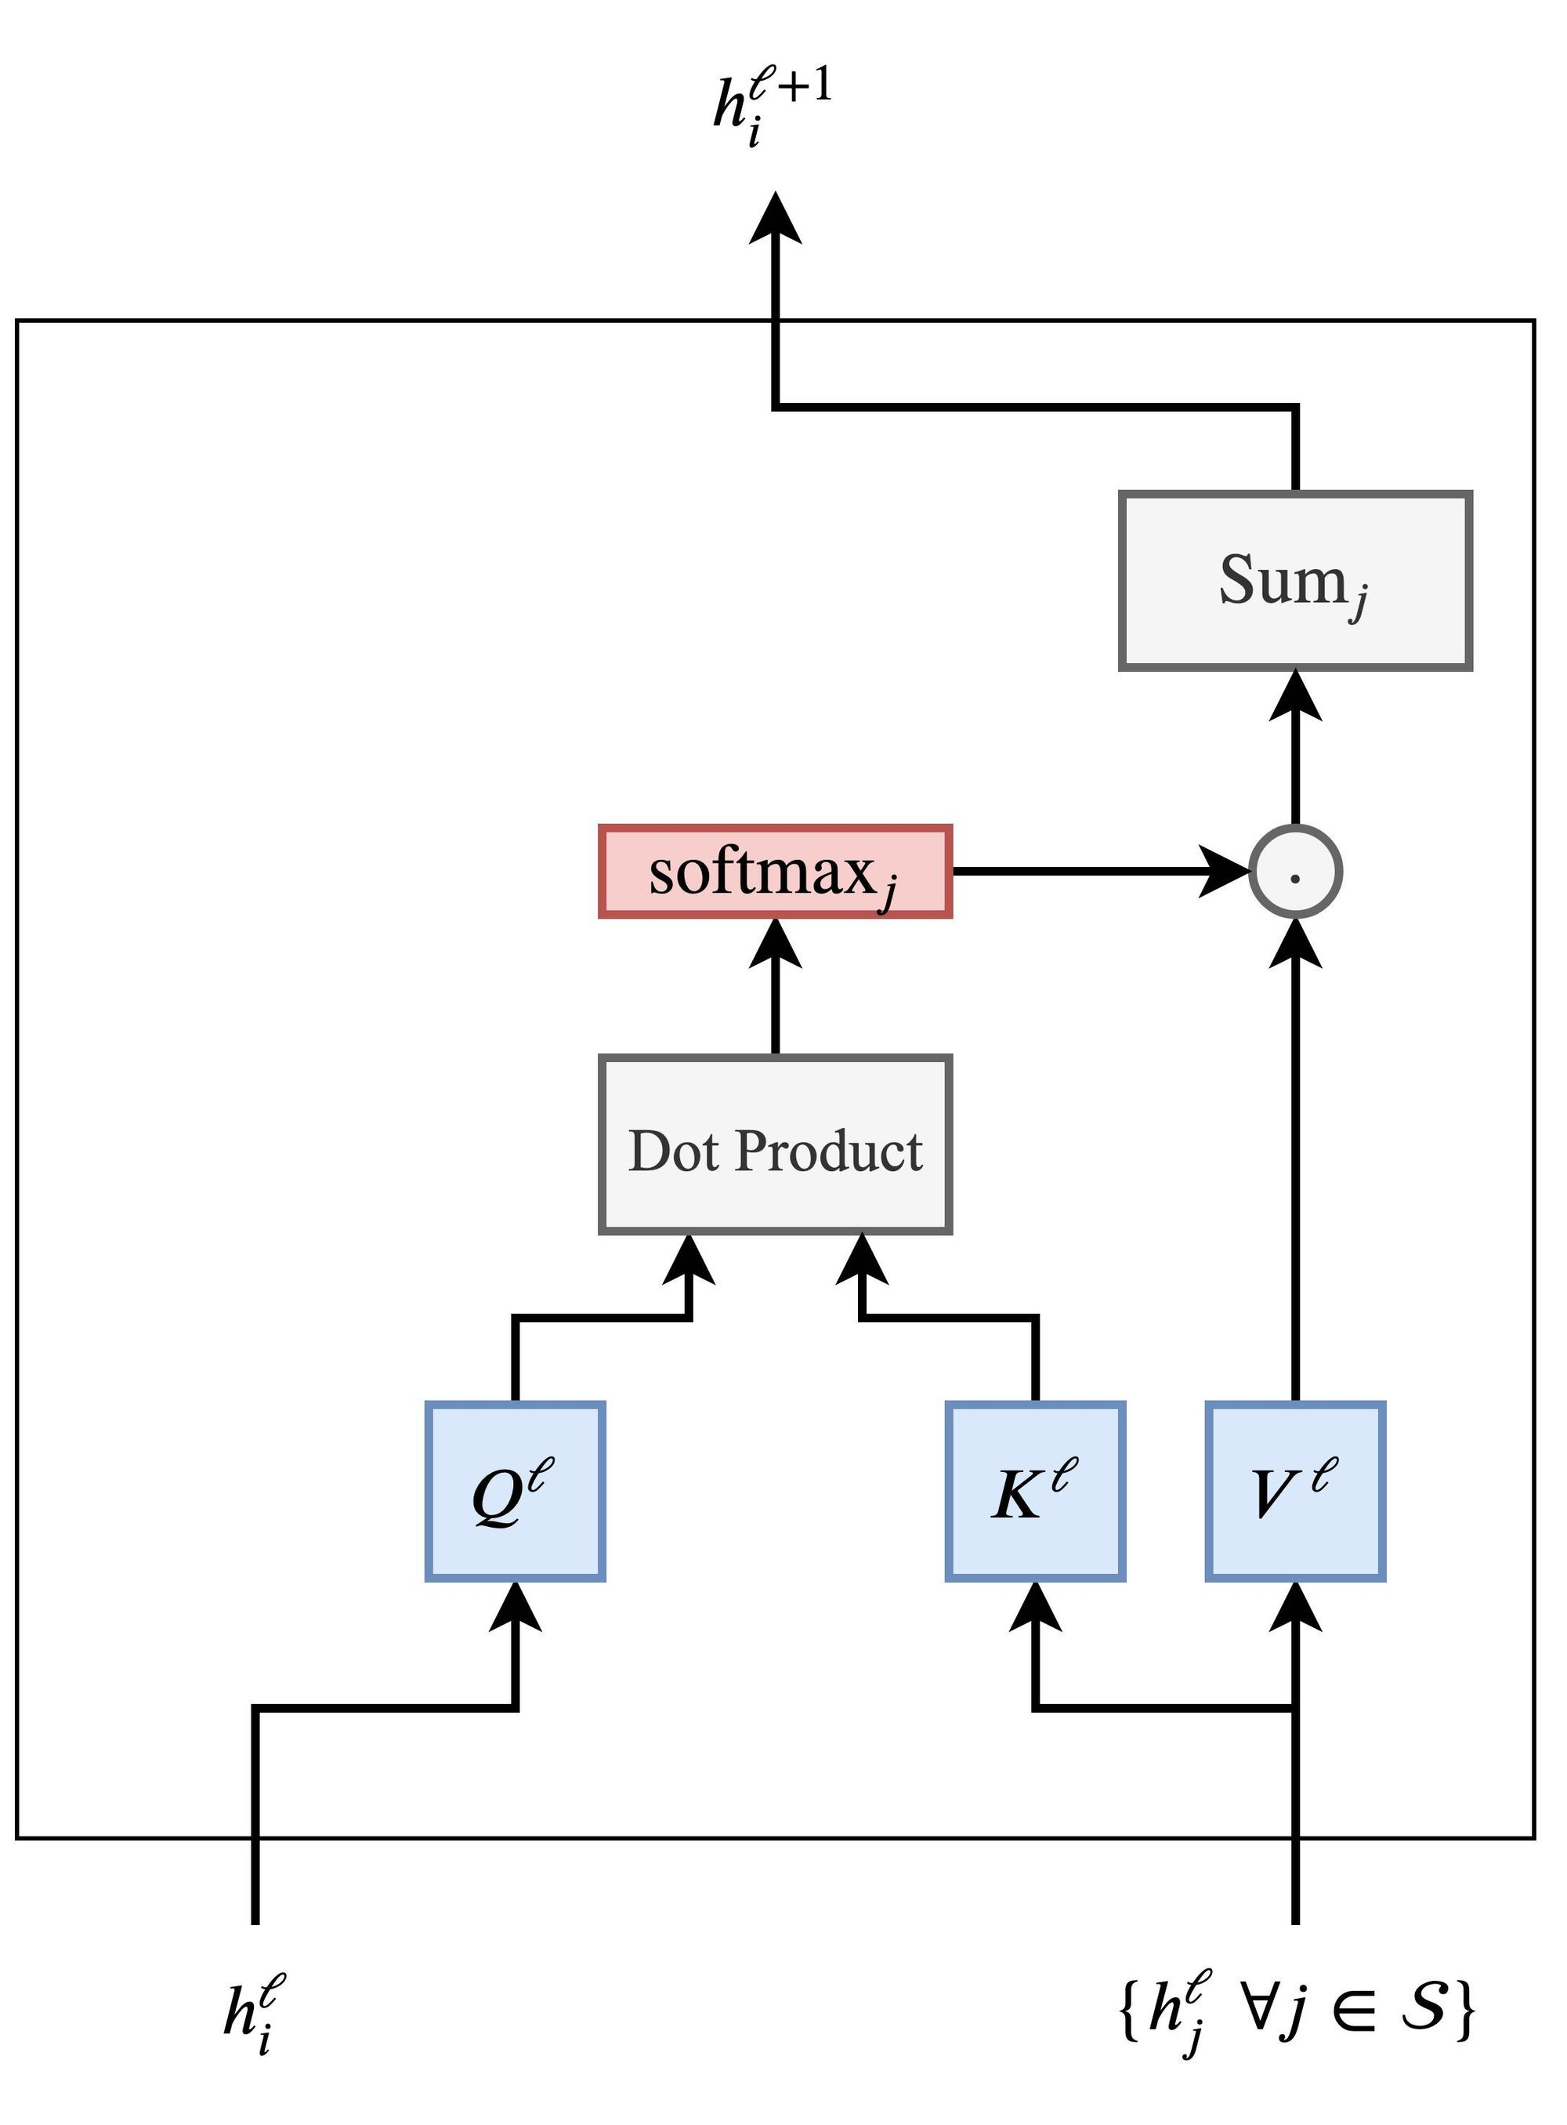
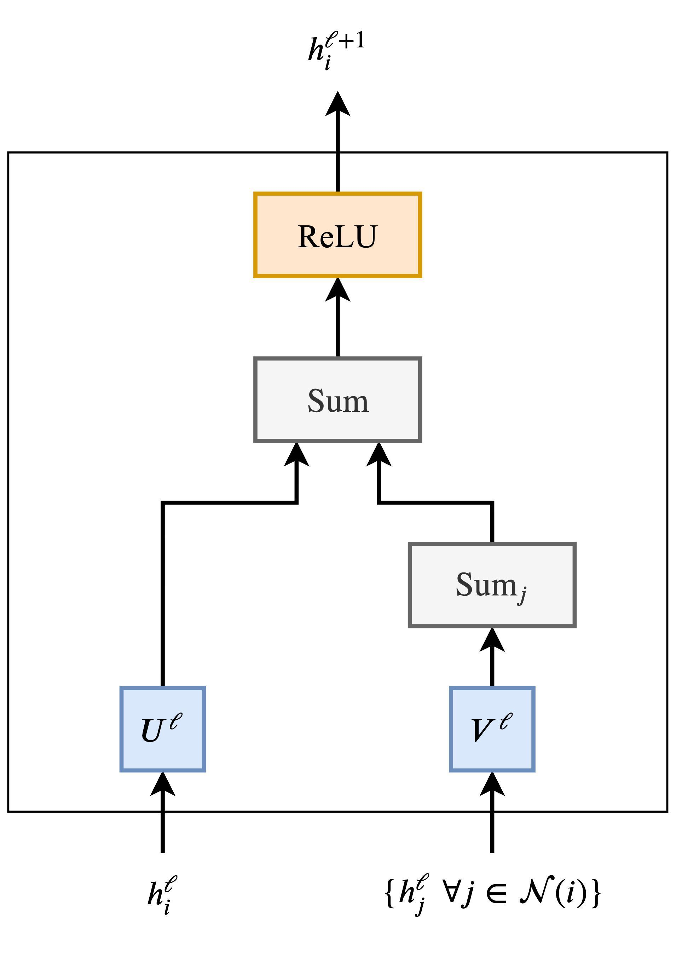
Question time
Which ones are correct?
A.) GNNs can be seen as a generalization of ConvNets
B.) ConvNets can be seen as a generalization of GNNs
An attention mechanism can be implemented using a GNN
C.) Yes, by building a fully connected graph
D.) Yes, by building a empty graph
E.) No, it is not possible
To convince yourself:
https://thegradient.pub/transformers-are-graph-neural-networks/

Slide 24
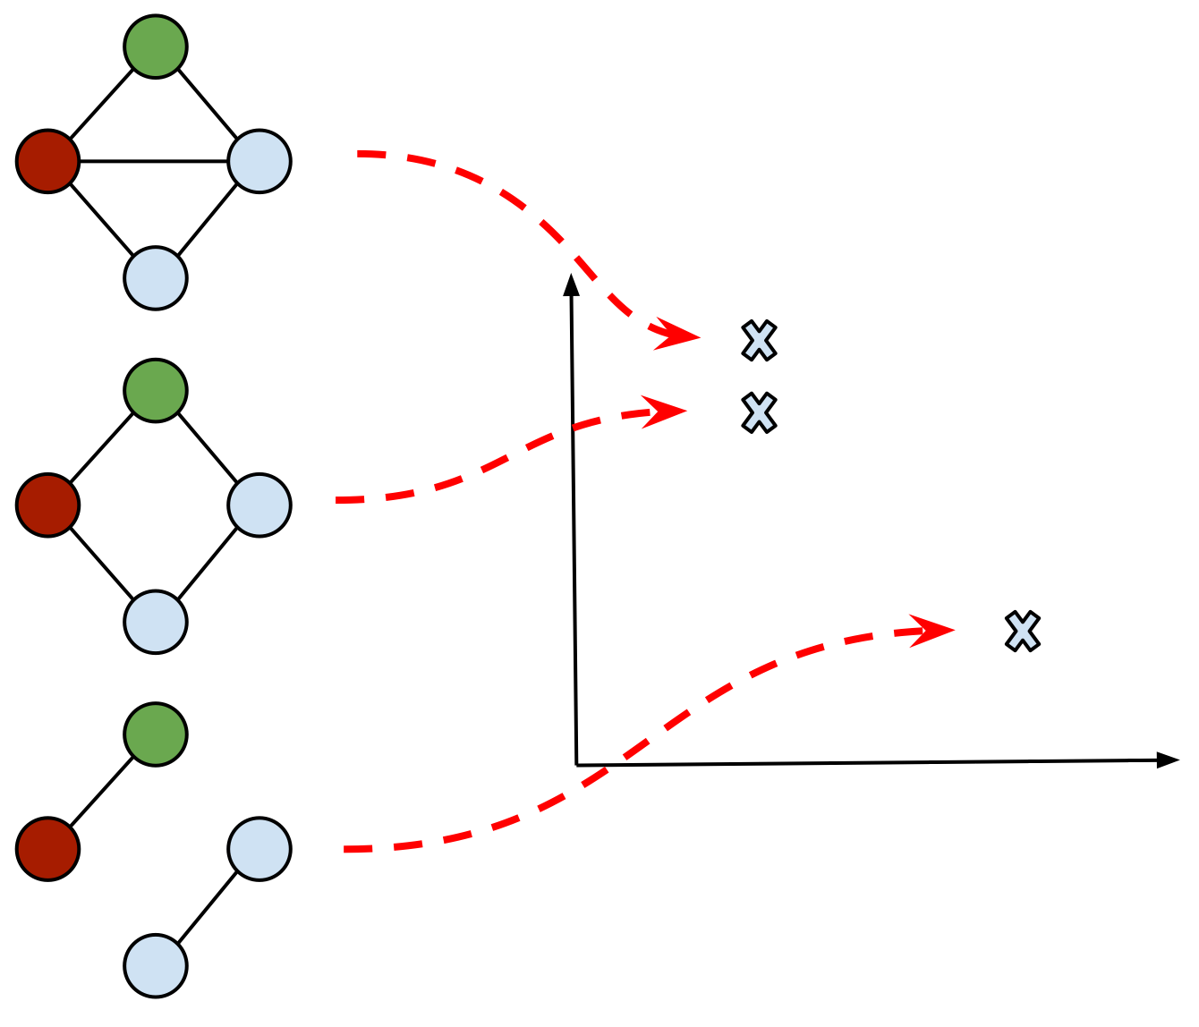
Expressive power of Graph Neural Network
What is a “good” GNN?
A GNN that maps different node
neighbourhoods to different embedding
locations
A GNN that maps similar node
neighbourhoods to similar embedding
locations

Slide 25
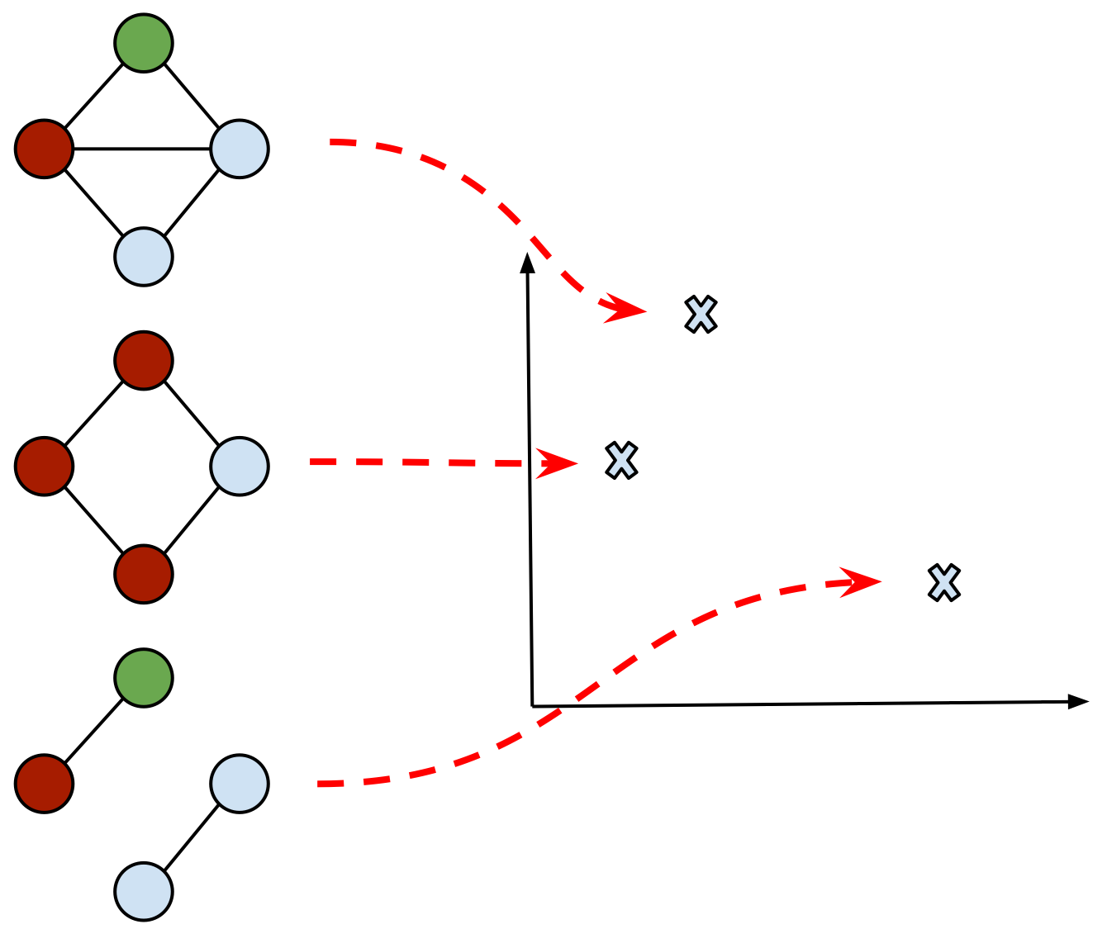
Expressive power of Graph Neural Network
What is a “good” GNN?
A GNN that maps different node
neighbourhoods to different embedding
locations
A GNN that maps similar node
neighbourhoods to similar embedding
locations

Slide 26
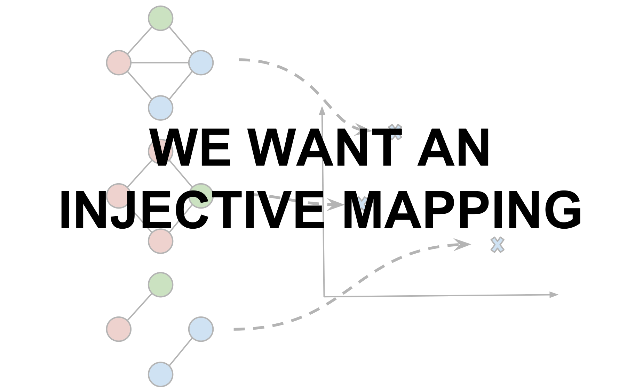
Expressive power of Graph Neural Network
What is a “good” GNN?
Can we be as powerful as isomorphism?

Slide 27
Expressive power of Graph Neural Network
What is a “good” GNN?
The Graph Isomorphism Network can
be as powerful as the Weisfeiler-Lehman (WL)
test of isomorphism
The proof is based on the strong relation
between the message passing of GNNs and
The 1-dimensional WL procedure
Source: Xu et al., How powerful are Graph Neural Networks
Morris et al., Weisfeiler and Leman Go Neural: Higher-order Graph Neural Networks
Jaume et al., edGNN: A simple and powerful GNN for directed labeled graphs

Slide 28
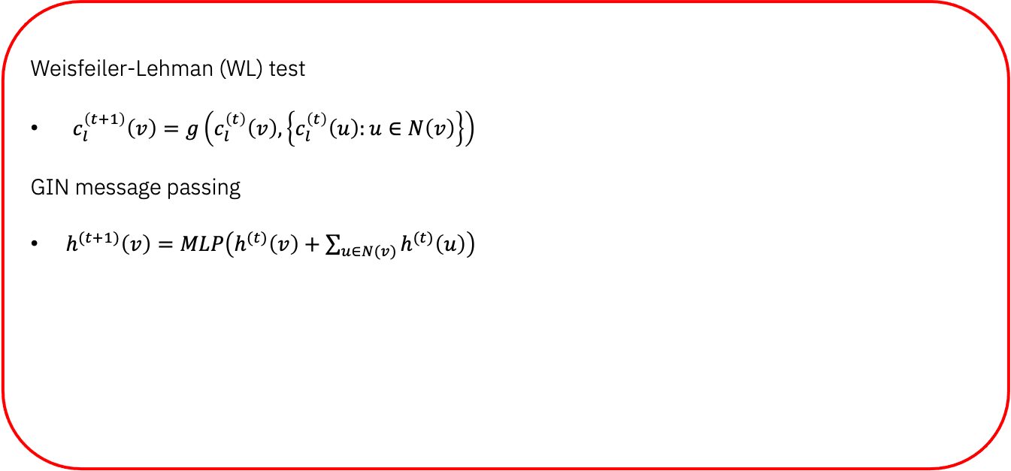
Expressive power of Graph Neural Network
What is a “good” GNN?
Weisfeiler-Lehman (WL) test
$c_{l}^{\left(t+1\right)}\left(v\right)=g\left(c_{l}^{\left(t\right)}\left(v\right), \left\{c_{l}^{\left(t\right)}\left(u\right):u∈N\left(v\right)\right\}\right)$
GIN message passing
$h^{(t+1)}\left(v\right)=MLP\left(h^{(t)}\left(v\right)+\sum_{u∈N(v)}{h^{(t)}\left(u\right)}\right)$
Source: Xu et al., How powerful are Graph Neural Networks
Morris et al., Weisfeiler and Leman Go Neural: Higher-order Graph Neural Networks
Jaume et al., edGNN: A simple and powerful GNN for directed labeled graphs

Slide 29
Expressive power of Graph Neural Network
What is a “good” GNN?
Weisfeiler-Lehman (WL) test
$c_{l}^{\left(t+1\right)}\left(v\right)=g\left(c_{l}^{\left(t\right)}\left(v\right), \left\{c_{l}^{\left(t\right)}\left(u\right):u∈N\left(v\right)\right\}\right)$
GIN message passing
$h^{(t+1)}\left(v\right)=MLP\left(h^{(t)}\left(v\right)+\sum_{u∈N(v)}{h^{(t)}\left(u\right)}\right)$
Extension to directed & edge-labeled graphs
Source: Xu et al., How powerful are Graph Neural Networks
Morris et al., Weisfeiler and Leman Go Neural: Higher-order Graph Neural Networks
Jaume et al., edGNN: A simple and powerful GNN for directed labeled graphs

Slide 30
Question time (a more advanced one)
Graph Neural Networks:
A.) can be as powerful as graph isomorphism
B.) are more expressive than isomorphism
C.) are always better than graph kernel-based approaches
D.) can express any graph property

Slide 31
Question time (a more advanced one)
Graph Neural Networks:
A.) can be as powerful as graph isomorphism
B.) are more expressive than isomorphism
C.) are always better than graph kernel-based approaches
D.) can express any graph property

Slide 32
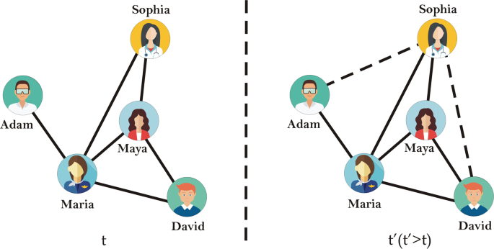
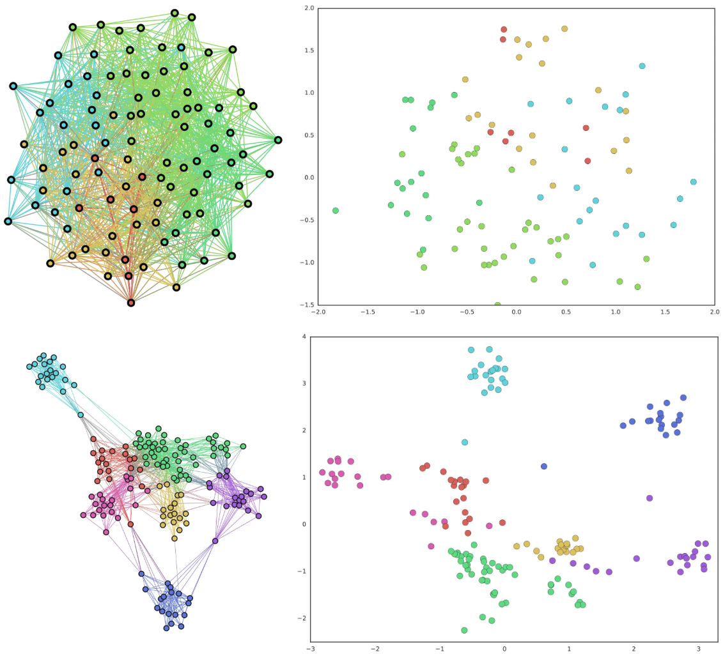
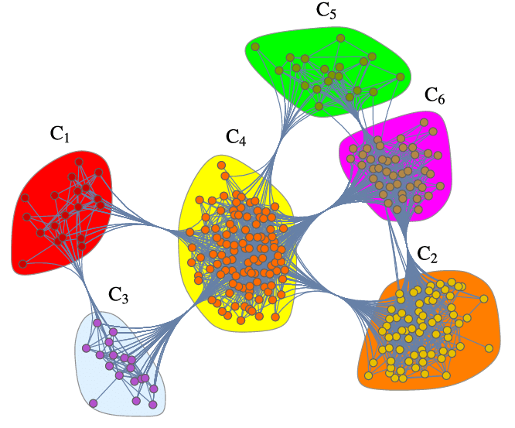
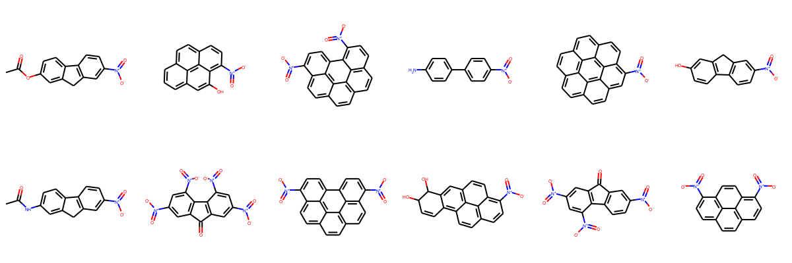
When can we use GNNs?
Graph classification
Node classification
Community detection
Link prediction

Slide 33
Question time (more of a disclaimer actually)
There exists:
A.) One way to do graph convolution
B.) 10+ ways to do graph convolution
C.) 100+ ways to do graph convolution

Slide 34
Question time (more of a disclaimer actually)
There exists:
A.) One way to do graph convolution
B.) 10+ ways to do graph convolution
C.) 100+ ways to do graph convolution

Slide 35
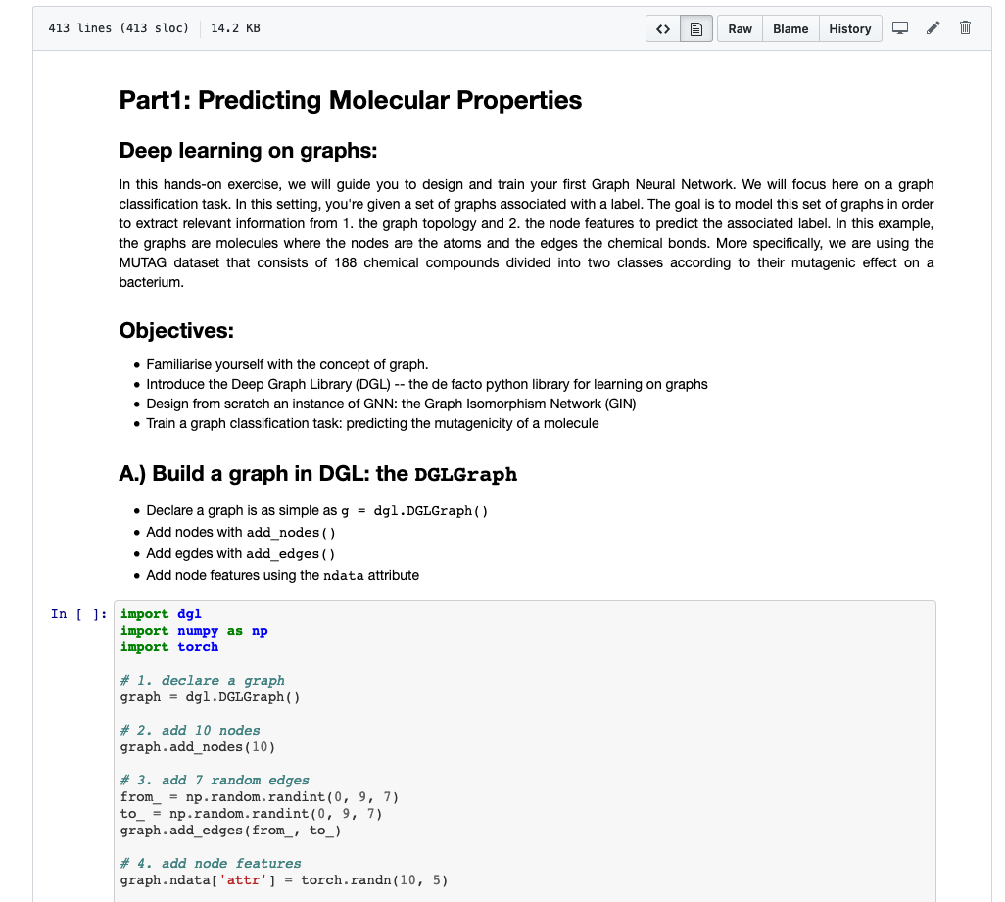
Hands-on exercise: Predicting molecular properties
https://github.ibm.com/GraphsZRL/tutorial-ml-on-graphs/blob/master/notebooks/Part1%20-%20Predicting%20molecular%20properties.ipynb

Slide 36
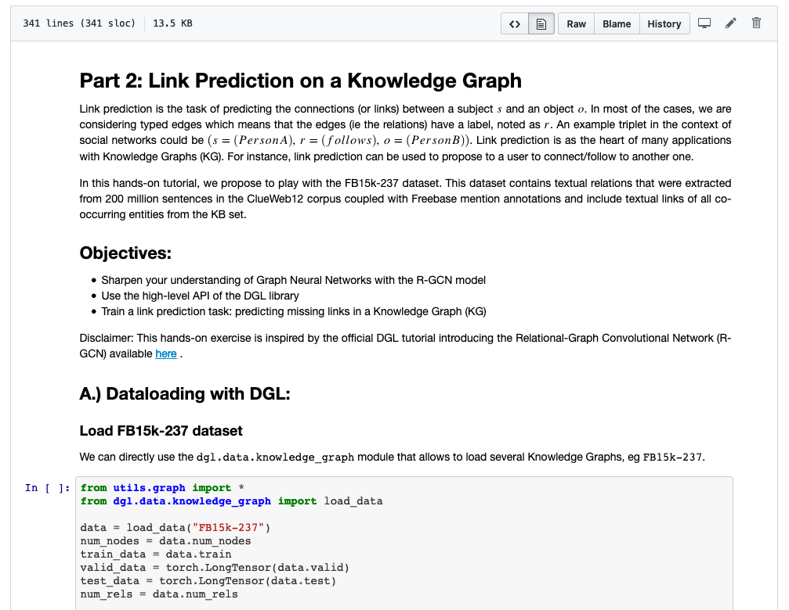
Hands-on exercise: Link prediction on a knowledge graph
https://github.ibm.com/GraphsZRL/tutorial-ml-on-graphs/blob/master/notebooks/Part2%20-%20Link%20Prediction%20on%20a%20Knowledge%20Graph.ipynb

Slide 37
GNN by topic
List of relevant papers sorted by topic available here:
https://github.com/guillaumejaume/graph-neural-networks-roadmap

Slide 38
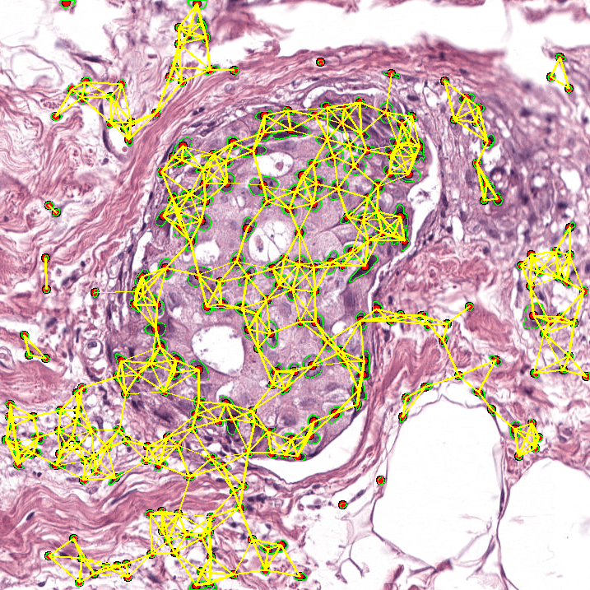


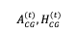
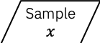
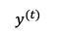
GNN by topic: Interpretability
Non-interpretable
GNN model
Graph pruning
GNNExplainer: Generating Explanations for Graph Neural Networks, NeurIPS, 2019
Visualization for Histopathology Images using Graph Convolutional Neural Networks, arXiv, 2020
Explainability Methods for Graph Convolutional Neural Networks, CVPR, 2019
Layerwise Relevance Visualization in Convolutional Text Graph Classifiers, EMNLPW, 2019
XAI for Graphs: Explaining Graph Neural Network Predictions by Identifying Relevant Walks, arXiv, 2020
Explainability Methods for Graph Convolutional Neural Networks, CVPR, 2019
XGNN: Towards Model-Level Explanations of Graph Neural Networks, arXiv, 2020
C0
C2
C1
C3
$$y^{(t)}$$
$$A_{CG}^{(t)}, H_{CG}^{(t)}$$
$$\hat{y}=f(x)$$
Blackbox DL model
Sample$x$
C0
C2
C1
C3
Explanation model
DOCTOR
$$e(\hat{y})$$
Jaume et al. Towards Explainable Graph Representation in
Digital pathology. ICML-w, 2020.

Slide 39
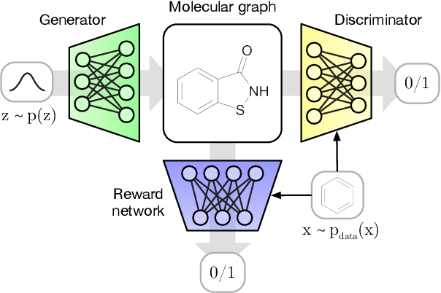
GNN by topic: Generative modelling
J. You, R. Ying, X. Ren, W. L. Hamilton, J. Leskovec, GraphRNN: Generating Realistic Graphs with Deep Auto-regressive Models, ICML, 2018
Y. Li, O. Vinyals, C. Dyer, R. Pascanu, P. Battaglia, Learning Deep Generative Models of Graphs, 2018
J. You, B. Liu, R. Ying, V. Pande, and J. Leskovec, Graph Convolutional Policy Network for Goal-Directed Molecular Graph Generation, NeurIPS, 2018
M. Simonovsky, N. Komodakis GraphVAE: Towards Generation of Small Graphs Using Variational Autoencoders, 2018
W. Jin, R. Barzilay, T. Jaakkola, Junction Tree Variational Autoencoder for Molecular Graph Generation, ICML, 2018
N. De Cao and T. Kipf, MolGAN: An implicit generative model for small molecular graphs, 2018
Q. Liu, M. Allamanis, M. Brockschmidt, A. L. Gaunt Constrained Graph Variational Autoencoders for Molecule Design, NeuIPS, 2018
A. Grover, A. Zweig, S. Ermon, Graphite: Iterative Generative Modeling of Graphs, ICML, 2019
C. Yang, P. Zhuang, W. Shi, A. Luu, P. Li, Conditional Structure Generation through Graph Variational Generative Adversarial Nets, NeurIPS, 2019
R. Liao, Y. Li, Y. Song, S. Wang, C. Nash, W. L. Hamilton, D. Duvenaud, R. Urtasun, R. S. Zemel, Efficient Graph Generation with Graph Recurrent Attention Networks, NeurIPS, 2019

Slide 40
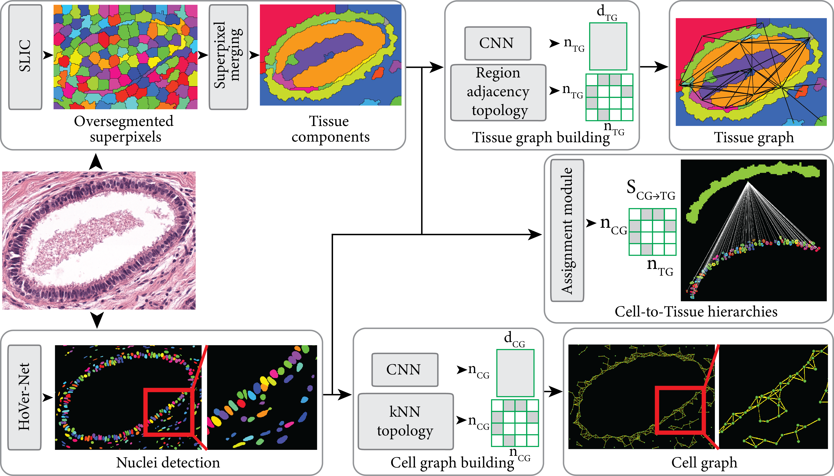
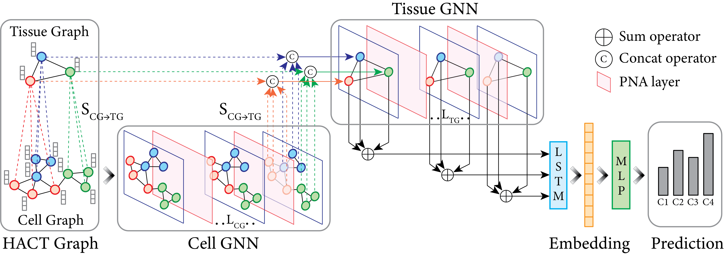
GNN by topic: Medical Imaging
HACT-Net: A Hierarchical Cell-to-Tissue Graph Neural Network for Histopathological Image Classification. MICCAI, 2020.
CGC-net: Cell graph convolutional network for grading of colorectal cancer histology images. CVPR-w
Breast cancer histopathological image classification usinga hybrid deep neural network
Visualization for histopathology images using graphconvolutional neural networks
BrainGNN: Interpretable Brain Graph Neural Network for fMRI Analysis
Pati et al. HACT-Net: A Hierarchical Cell-to-Tissue
Graph Neural Network for Histopathological Image
Classification. MICCAI, 2020.

Slide 41

GNN by topic: …
Many more topics are today using Graph Neural Networks

